Slide 1

INSTITUTE OF AERONAUTICAL ENGINEERING
REVIEW-3
Department: Computer Science and Engineering
Project title: Optimizing Telecom Operations with Segmentation and Churn Prediction .
Mentor: Ms. K.Sangeeta , Assistant Professor, CSE Department.
Presented by –
D.Neha - 21951A05B8
Mohammed Ameesha - 21951A05A4 M.Dheeraj – 21951A0538

Slide 2
ABSTRACT
Telecom companies operate in highly competitive environments where customer churn poses a significant challenge. To address this issue, this explores the implementation of segmentation and churn prediction techniques to optimize telecom operations. By segmenting customers based on their behavior, preferences, and usage patterns, telecom companies can personalize their offerings and improve customer satisfaction. Additionally, employing churn prediction models enables proactive measures to retain at-risk customers, thereby reducing churn rates and enhancing revenue. This outlines the objectives and approaches utilized in optimizing telecom operations through segmentation and churn prediction.

Slide 3
INTRODUCTION
The telecommunications sector has displayed one of the central industries in
developed countries. Service companies like these suffer, particularly from
the loss of valuable customers due to competitors known as customer churn. The scientific progress and the growing number of operators increased the
level of opposition. Companies are pulling hard to survive in this aggressive
market, depending on complicated strategies.
The customer churn causes a considerable loss of telecom services and
becomes a severe problem. we aim to personalize customer experiences,
reduce churn rates, and allocate resources more effectively. The objective is
to maximize revenue growth by retaining high-value customers and improving
overall operational efficiency. Through data-driven insights and targeted
interventions, this project seeks to position our telecom company for success
in a dynamic and evolving marketplace.

Slide 4
OBJECTIVES
1. Enhance Customer Segmentation Accuracy:
Improve the precision and granularity of customer segmentation to better understand customer behavior and preferences.
2. Predict Customer Churn Proactively:
Anticipate and prevent customer churn by identifying at-risk customers and implementing proactive retention strategies.
3. Optimize Resource Allocation and Network Management:
Enhance network efficiency, capacity planning, and resource allocation to improve service quality and minimize operational costs.
4. Enhance Customer Experience and Service Quality:
Deliver personalized services, resolve issues promptly, and enhance overall customer experience to increase satisfaction and loyalty.

Slide 5
PROPOSED APPROACH
In this system, we use various algorithms like K-Nearest Neighbors (KNN), Decision Tree, and Support Vector Machine (SVM) classifiers. This example assumes you have a dataset with features and a target variable indicating whether a customer has churned or not.To find accurate values and which helps us to predict the churn of the customer. Here we implement the model by having a dataset that is trained and tested, which makes us have maximum correct values.In the Initial step, data preprocessing is performed in which we do filtering data and convert data into a similar form, and then we make feature selection. we observe the behavior of the customer and analyze them. In the final step, we do analysis based on the results obtained and predict the customer churn.

Slide 6
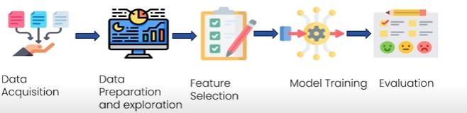
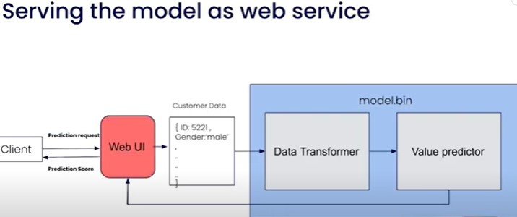
WORKFLOW
Workflow
Load and Preprocess Data
Customer Segmentation
Churn Prediction
Evaluate Models

Slide 7
LIBRARIES
Churn prediction is a common use case in machine learning where the goal is to predict whether a customer will leave (churn) or stay with a company. To implement churn prediction, you can use a variety of Python libraries. Here, We are using some key libraries :
Data Manipulation and Cleaning
Pandas:
Used for data manipulation and analysis.
Helps in loading, cleaning, and preprocessing data.
NumPy:
Provides support for large multi-dimensional arrays and matrices.
Contains a collection of mathematical functions.

Slide 8
LIBRARIES
Data Visualization
Matplotlib:
Basic plotting library in Python.
Used for creating static, animated, and interactive visualizations
Seaborn:
Built on top of Matplotlib.
Provides a high-level interface for drawing attractive and informative statistical graphics.
Machine Learning
Scikit-learn:
Comprehensive library for machine learning.
Contains simple and efficient tools for data mining and data analysis.

Slide 9
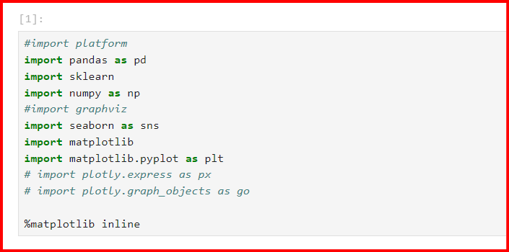
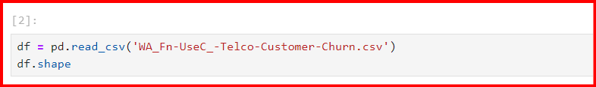
CODING

Slide 10
STEPS TO IMPLEMENT
Prerequisites for Building a Churn Prediction Model
Reviewing the Dataset
Exploratory Data Analysis for Customer Churn Prediction
Preprocessing Data for Customer Churn
Building the Customer Churn Prediction Model
Customer Churn Prediction Model Evaluation

Slide 11
ALGORITHMS
Support Vector Machines (SVM)
Support Vector Machines (SVM) can be effectively utilized for both customer segmentation and churn prediction in the telecom industry. For customer segmentation, SVM can be combined with clustering algorithms to identify distinct groups of customers based on their usage patterns, demographics, and billing information, enabling targeted marketing and personalized services. For churn prediction, SVM can classify customers into churn and non-churn categories by analyzing historical data, customer behavior, and service usage, helping telecom companies proactively address churn risks. By preprocessing data, selecting relevant features, and tuning model parameters, SVM can provide robust and accurate predictions, ultimately enhancing customer retention and satisfaction.

Slide 12
ALGORITHMS
Decision tree classifier
A Decision Tree classifier can effectively by leveraging its intuitive tree-structure approach to model decisions and outcomes based on customer data. For customer segmentation, the Decision Tree can segment customers by recursively partitioning the dataset into homogenous groups based on key attributes such as usage patterns, billing information, and demographics, facilitating targeted marketing and personalized services. For churn prediction, the model can identify patterns and indicators of churn by analyzing historical customer behavior and interactions, allowing for the prediction of at-risk customers.The interpretability of Decision Trees makes it easy to understand the decision rules driving both segmentation and churn predictions, enabling telecom companies to implement proactive retention strategies and enhance customer satisfaction.

Slide 13
ALGORITHMS
KNN classifier
K-Nearest Neighbors (KNN) classifier can be effectively utilized for both telecom customer segmentation and churn prediction. For customer segmentation, KNN can classify customers into distinct segments based on their similarity in usage patterns, demographics, and other relevant features, enabling targeted marketing strategies. In churn prediction, KNN identifies customers likely to churn by comparing them with similar customers who have previously left, leveraging historical data to predict churn risk. By analyzing the 'nearest neighbors' in a multidimensional feature space, KNN provides intuitive and interpretable insights, making it a valuable tool for enhancing customer retention and optimizing service offerings in the telecom industry.

Slide 14
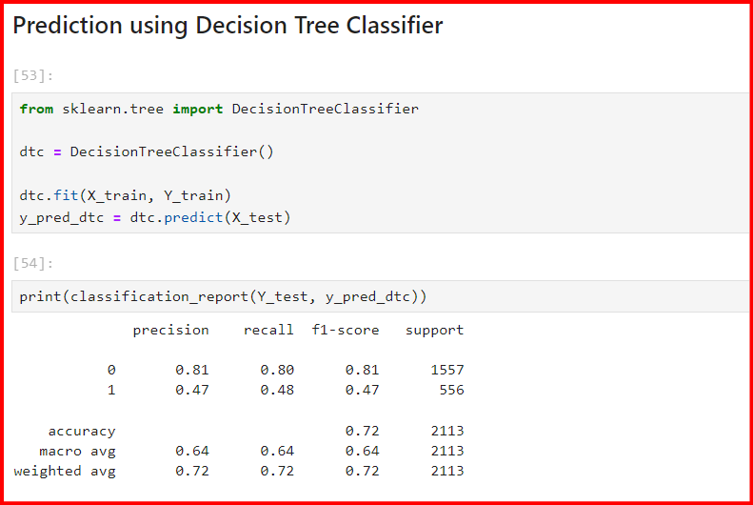
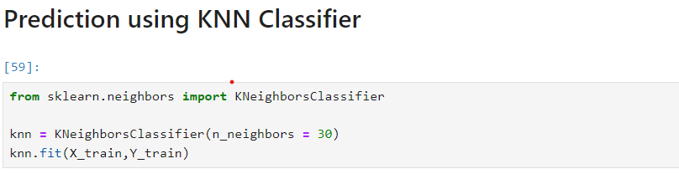
CODING

Slide 15
EXPECTED RESULT
1. Improved Churn Prediction Accuracy: Achieve a higher accuracy rate in predicting customer churn, leading to early identification of at-risk customers and proactive retention efforts.
2. Reduction in Churn Rate: Realize a measurable decrease in overall churn rate among targeted customer segments, resulting in improved customer retention and reduced revenue loss.
3. Enhanced Customer Segmentation: Utilize advanced segmentation to deliver personalized interventions and offers, resulting in increased customer satisfaction and loyalty.
4. Increase in Customer Lifetime Value (CLV): Improve CLV by retaining high-value customers identified through churn prediction models, leading to higher revenue generation over the customer

Slide 16
EXPECTED RESULT
5. Optimized Resource Allocation: Allocate resources more efficiently by focusing efforts on retaining existing customers rather than solely acquiring new ones, leading to improved operational efficiency and cost savings.
6. Positive Impact on Revenue and Profitability: Ultimately, achieve a positive impact on revenue and profitability through reduced churn, increased customer engagement, and optimized retention strategies.

Slide 17
CONCLUSION
The importance of churn prediction will help many companies, mainly in telecom industries, to have a profitable income and achieve good revenue. Customer churn prediction is the major issue in the Telecom Industry, and due to this, companies are trying to keep the existing ones from leaving rather than acquiring a new customer.

Slide 18


